Slide 1
The Manhattan Project
The pursuit of Scientific Discovery…….at what cost?

Slide 2
What was the “Manhattan Project”?
Atomic Bomb Project – Began in 1941
Successful – Japan is issued an ultimatum
On August 5, 1945 a plane dropped an atomic bomb on the city of Hiroshima in Japan
("The Manhattan Project - 51.F")

Slide 4
The result?
70,000 killed instantly
100,000 people died later from radiation poisoning
Japan still doesn’t surrender
("Counting the Dead")

Slide 5
In Response….
Soviet forces attack Japan by land
Americans drop another bomb - Nagasaki, Japan
Japan Surrenders
("Japan Surrenders - Sept. 2, 1945")

Slide 6
The Scientists
Albert Einstein
Enrico Fermi
Robert Oppenheimer
("The Manhattan Project - 51.F")

Slide 7
Einstein and Fermi

Slide 8
Einstein: "I made one great mistake in my life... when I signed the letter to President Roosevelt recommending that atom bombs be made; but there was some justification - the danger that the Germans would make them."
(Clark)

Slide 9
Enrico Fermi
Fermi, the “father of the atomic bomb” dies at 53 of stomach cancer and issues this “Frankenstein” type warning:

Slide 10
Some of you may ask, what is the good of working so hard merely to collect a few facts which will bring no pleasure except to a few long-haired professors who love to collect such things and will be of no use to anybody because only few specialists at best will be able to understand them? In answer to such question[s] I may venture a fairly safe prediction. History of science and technology has consistently taught us that scientific advances in basic understanding have sooner or later led to technical and industrial applications that have revolutionized our way of life. It seems to me improbable that this effort to get at the structure of matter should be an exception to this rule. What is less certain, and what we all fervently hope, is that man will soon grow sufficiently adult to make good use of the powers that he acquires over nature.
^{How} many WORDS?!!!!
DO NOT PUT THIS MANY WORDS ON A SLIDE!!!!

Slide 11
Robert Oppenheimer
Oppenheimer , the architect of the laboratory at Las Alamos where the bomb was developed, issues this opinion:

Slide 12
"I have no remorse about the making of the bomb and Trinity [the first test of an a-bomb]. That was done right. As for how we used it, I understand why it happened and appreciate with what nobility those men with whom I'd worked made their decision. But I do not have the feeling that it was done right. The ultimatum to Japan [the Potsdam Proclamation demanding Japan's surrender] was full of pious platitudes. ...our government should have acted with more foresight and clarity in telling the world and Japan what the bomb meant."
Can you really read this size font??
THIS FONT IS TOO SMALL!!

Slide 13
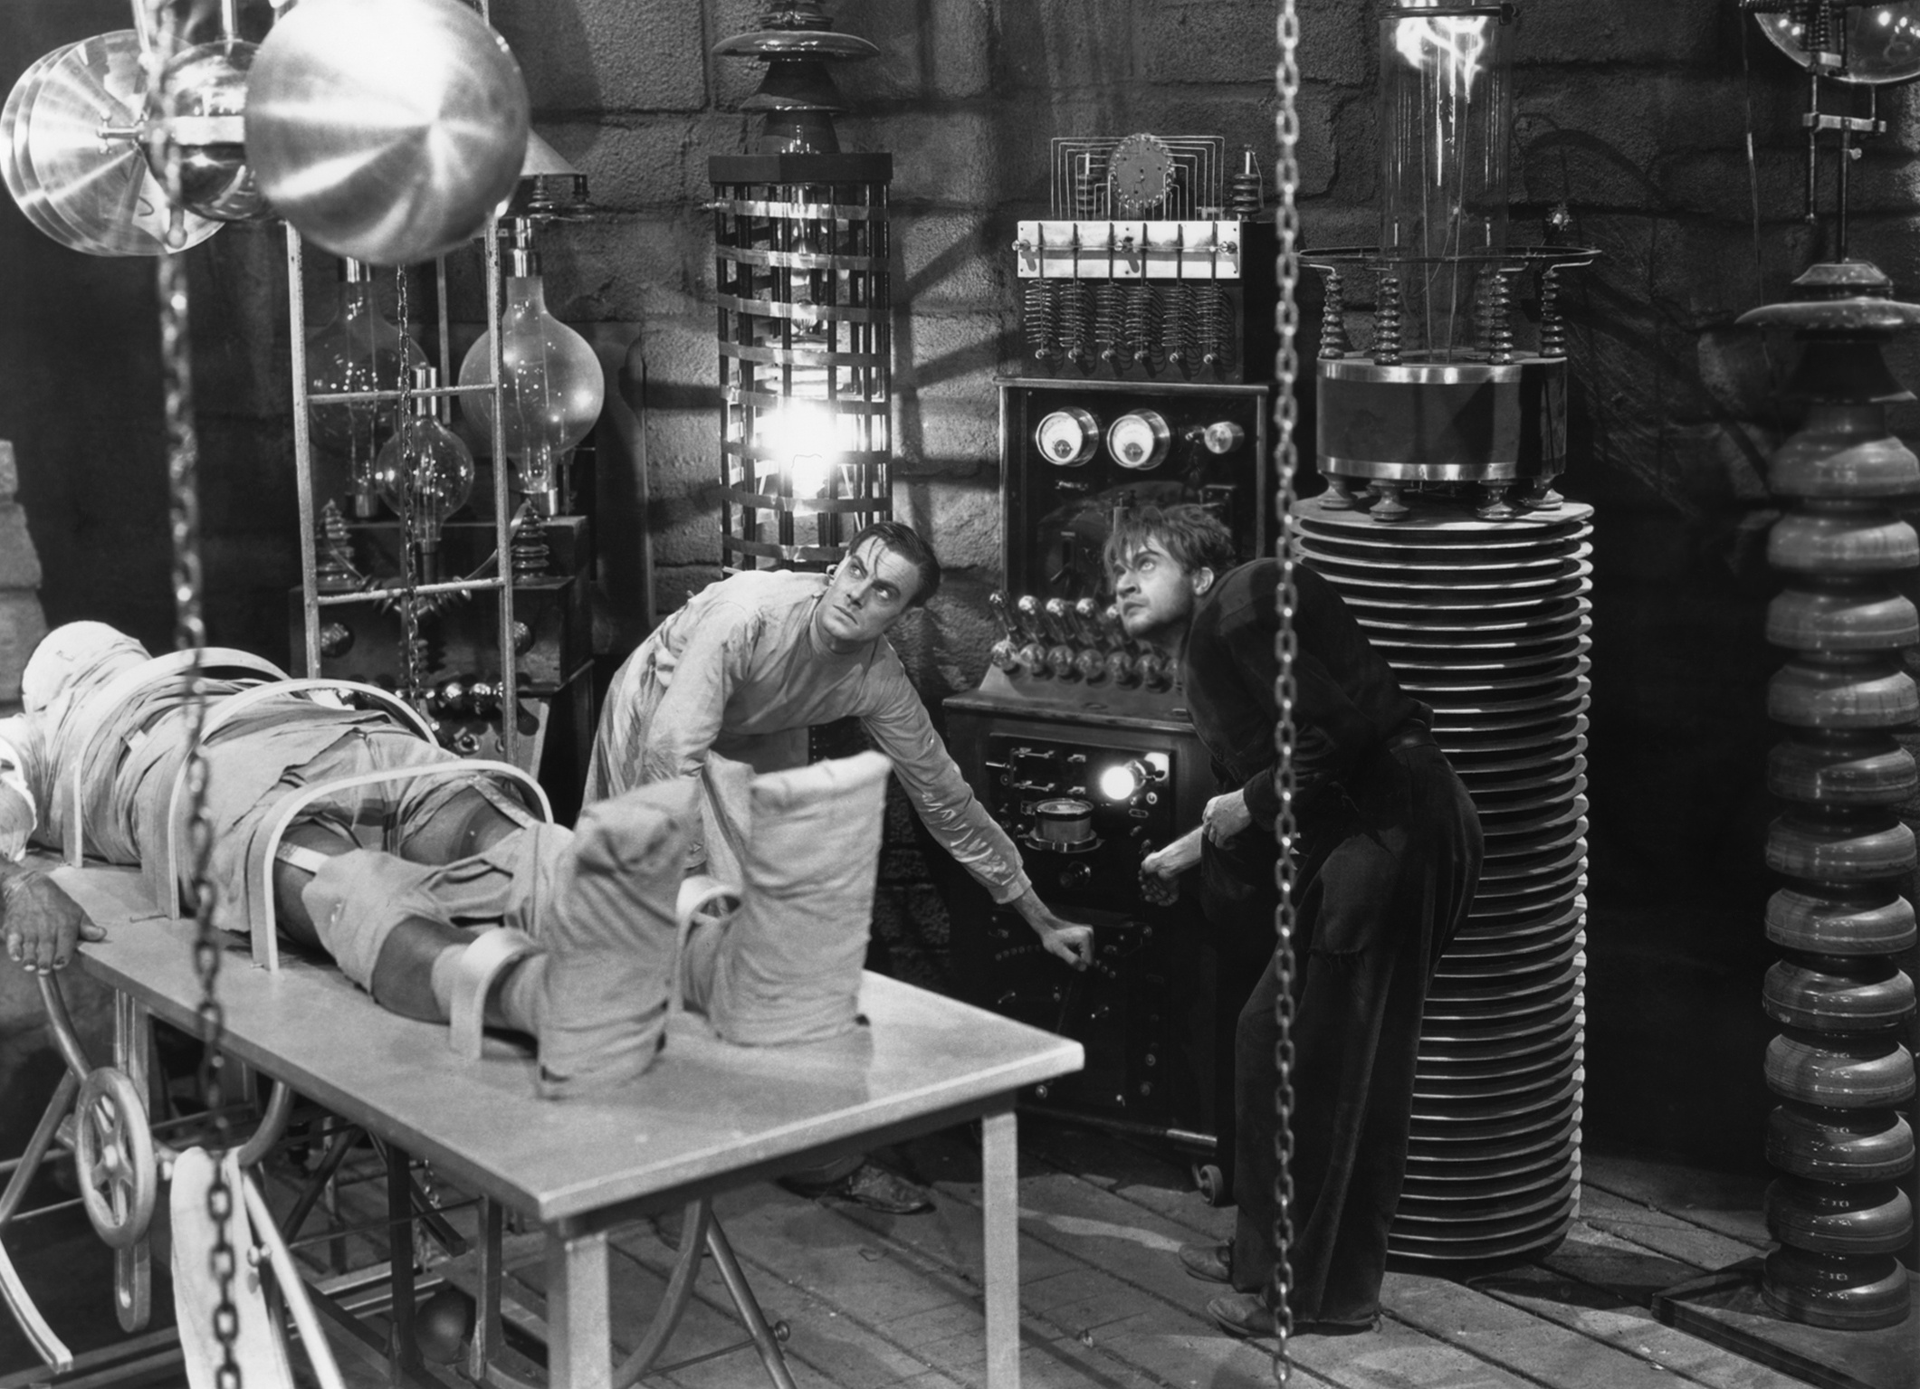
Connections to Frankenstein
Connections to Frankenstein

Slide 14
Initially the pursuit was pure science/exploration. Application of the science led to the ethical dilemma.

Slide 15
While all the scientists sought their creation, all wrestled with the moral and ethical implications of the result.

Slide 16
Works Cited
Clark, Ronald. "Einstein: The Life and Times." Albert Einstein and the Atomic Bomb. N.p.. Web. 3 Dec 2014. <http://www.doug-long.com/einstein.htm>.
"Counting the Dead." Health Effects. Atomic Bomb Museum.org. Web. 3 Dec 2014.
<http://atomicbombmuseum.org/3_health.shtml>.
"Japan Surrenders - Sept. 2, 1945." This Day in History. The History Channel. Web. 3 Dec 2014. <http://www.history.com/this-day-in-history/japan-surrenders>.
"The Manhattan Project - 51.F." U.S. History Pre-Columbian to the New Millennium. U.S. History.org. Web. 3 Dec 2014. <http://www.ushistory.org/us/51f.asp>.

